Slide 1



sales analysis dashboard
View in Power BI
Last data refresh:
3/17/2023 8:34:22 AM UTC
Downloaded at:
3/17/2023 8:41:42 AM UTC

Slide 2
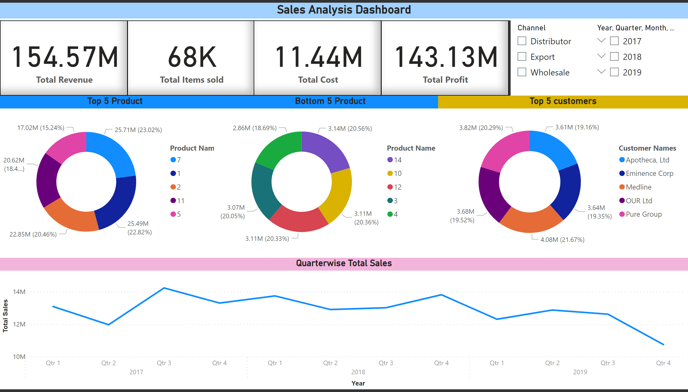
Page 1
Notes:
card
No alt text provided
card
No alt text provided
card
No alt text provided
card
No alt text provided
slicer
No alt text provided
textbox
No alt text provided
slicer
No alt text provided
Top 5 Product
No alt text provided
Bottom 5 Product
No alt text provided
Top 5 customers
No alt text provided
Quarterwise Total Sales
No alt text provided
Sales Analysis Dashboard
No alt text provided

